Slide 1
Introduction to GraphQL
Krishna Regmi

Slide 2
Before we start!!
First and foremost, it’s an abstraction.
You can do everything with or without GraphQL, but having GraphQL saves you time and effort.
On top of code abstraction, GraphQL also gives you a thinking model that enables better collaboration with other developers.
GraphQL ultimately makes it easier to build and maintain web applications.
There are applications where GraphQL is not the correct tool for the job.

Slide 3
Why Industry Leaders are using GraphQL
Facebook (also the creator)
GraphQL APIs has been powering their news feed since 2012
Capital One
Uses GraphQL as a way of wiring up various sources of data in their data analytics team.
Intuit
Uses GraphQL to connect all of their micro services together
Tinder
Uses GraphQL to power their Blog called Swipe Life
GitLab
Planning on moving completely to GraphQL based data API because of flexibility it provides
Expedia / Airbnb
Use GraphQL to power their Frontends (website, app, client specific sites)

Slide 4
Why did we decide to use GraphQL with CXP?
Complex web of data sources that need to be wired up together
CXP needs will continue evolving. This enables us to not have to change our backend, even as frontend evolves
Faster development time because of self-documenting API and queries

Slide 5
What’s in the Name?
Graph + QL

Slide 6
Graph
Consider your application data as a graph of nodes that are connected.
Customer: Tyson
Customer: Honda
Order: June 2018
Order: July 2018
Product: S900
Product: S800
Document:
Invoice
Document: Cleaning Guide
Document:
SLA Agreement
Image

Slide 7
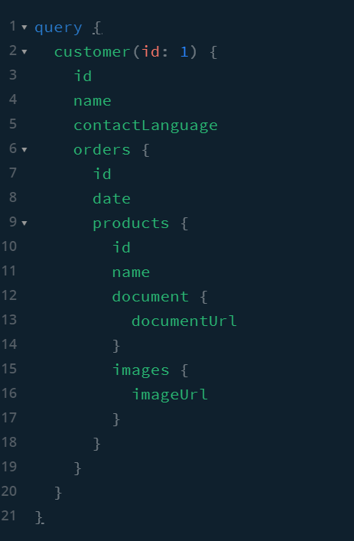
QL
Query Language
Customer: Tyson
Customer: Honda
Order: June 2018
Order: July 2018
Product: S900
Product: S800
Document:
Invoice
Document: Cleaning Guide
Document:
SLA Agreement
Image

Slide 8
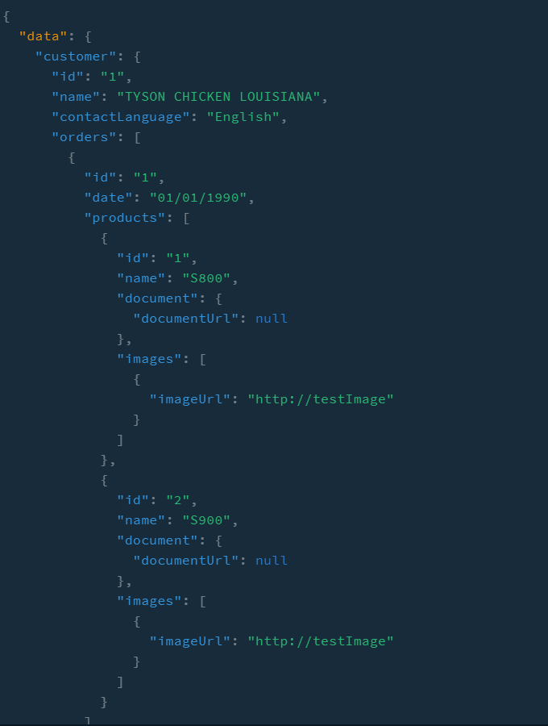
Image

Slide 9
GraphQL lets you start at any node in the graph

Slide 10
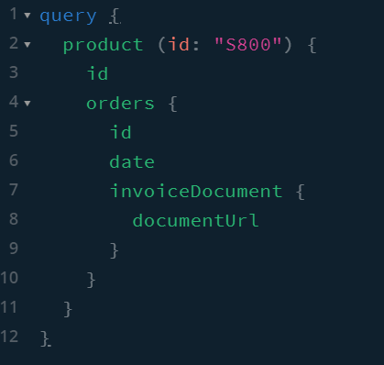
GraphQL lets you start at Any Node
Customer: Tyson
Customer: Honda
Order: June 2018
Order: July 2018
Product: S900
Product: S800
Document:
Invoice
Document: Cleaning Guide
Document:
SLA Agreement
Image

Slide 11
Components of GraphQL API

Slide 12
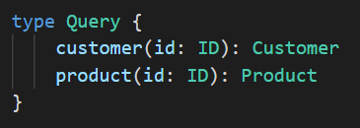
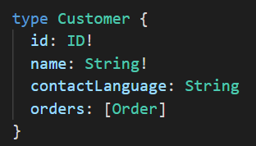
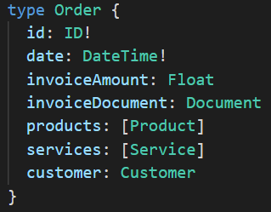
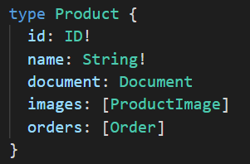
Components of GraphQL API
Schema
Schema defines the data your API returns.
Declare what nodes can be queried
Declare what values exist on each node, and their types
Resolvers
Query / Mutation / Subscription

Slide 13
Components of GraphQL API
Schema
Resolvers
Resolver is a function that gets the data requested
GraphQL runtime only runs resolvers necessary
Permissions can be applied on each resolver function
Query / Mutation / Subscription

Slide 14
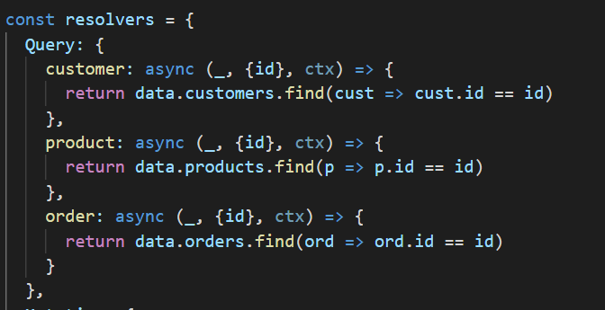
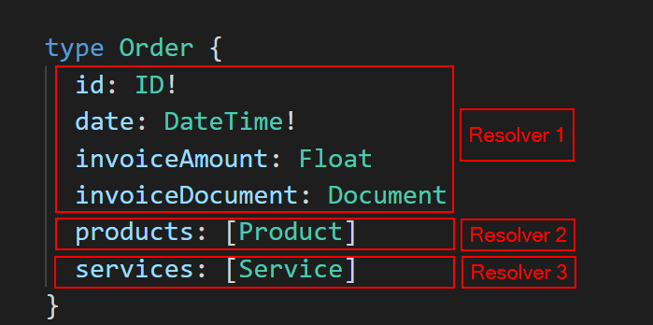
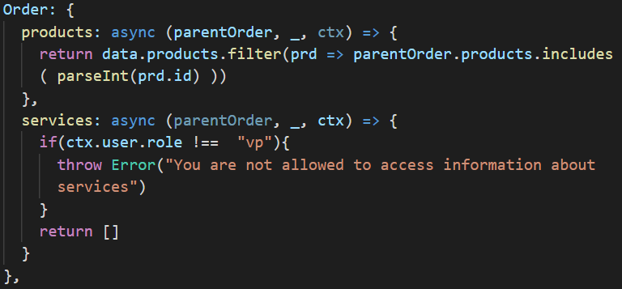
Components of GraphQL API
Root Resolver

Slide 15
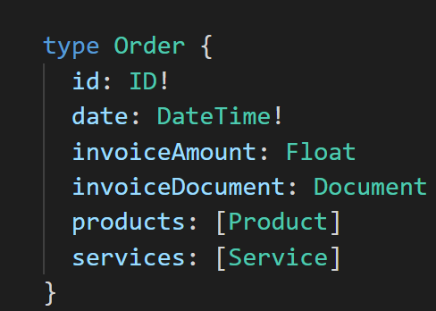
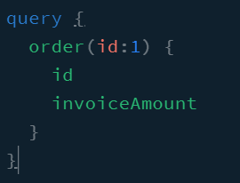
Components of GraphQL API

Slide 16
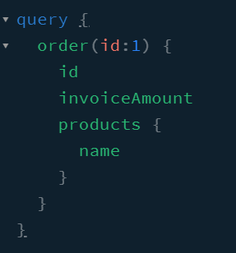
Components of GraphQL API

Slide 17
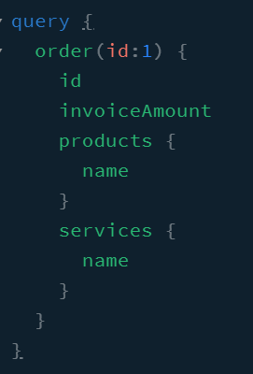
Components of GraphQL API

Slide 18
Components of GraphQL API
Schema
Resolvers
Query / Mutation / Subscription
Query: Used to read data
Mutation: Used to Edit/Create data
Subscriptions: Used for Real-Time data
Use Query language for all three.

Slide 19
GraphQL enables efficient data loading

Slide 20
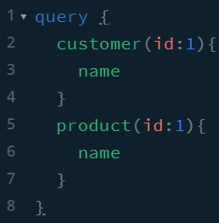
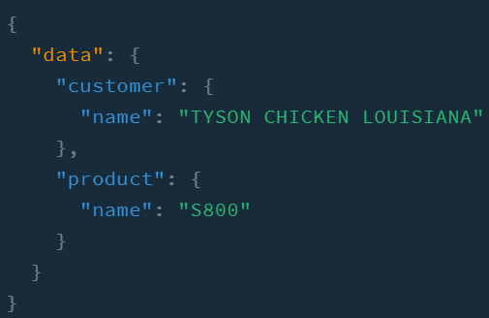
GraphQL enables efficient data loading
Get only what you ask for
Just the requested data is transferred through the network. No more, no less.
You only need one request to the backend no matter how you traverse the data graph
Multiple graph traversals can be combined into one request, reducing network delays
As a result of the architecture:
Speed to features when data requirement changes
One can read the query in the frontend code and clearly understand what data comes back without having to be familiar with the backend.

Slide 21
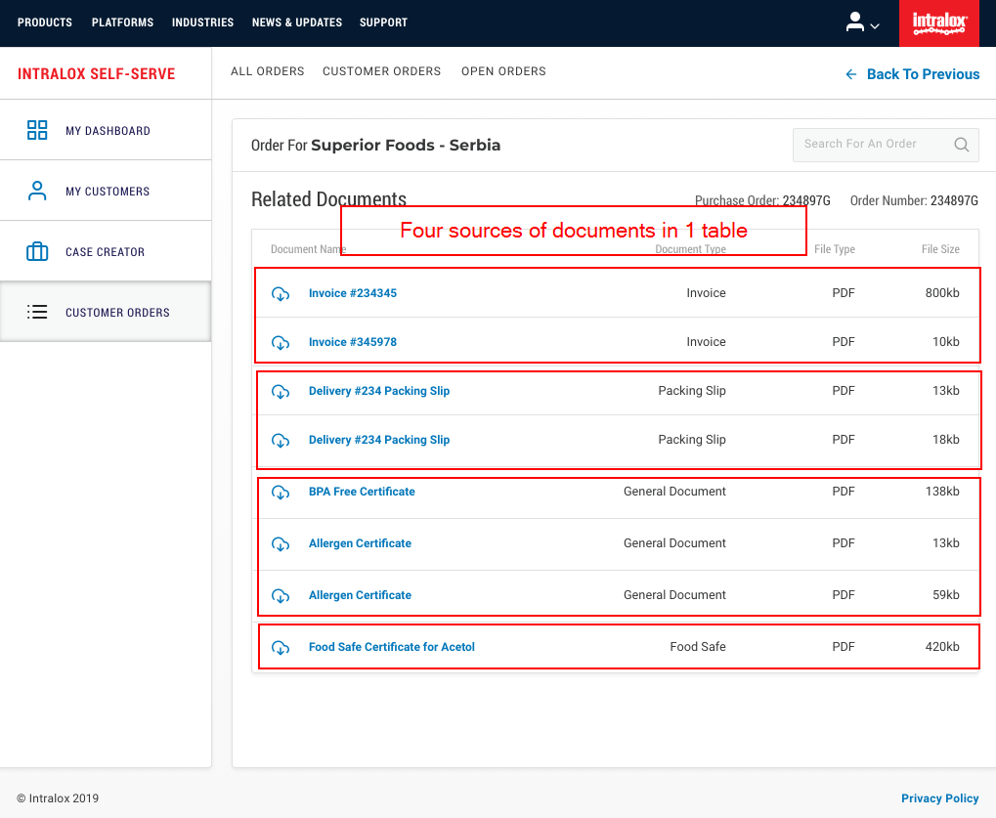
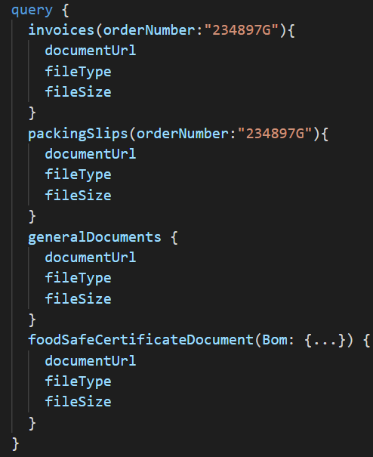
GraphQL enables efficient data loading
Image Source: CXP wireframes

Slide 22
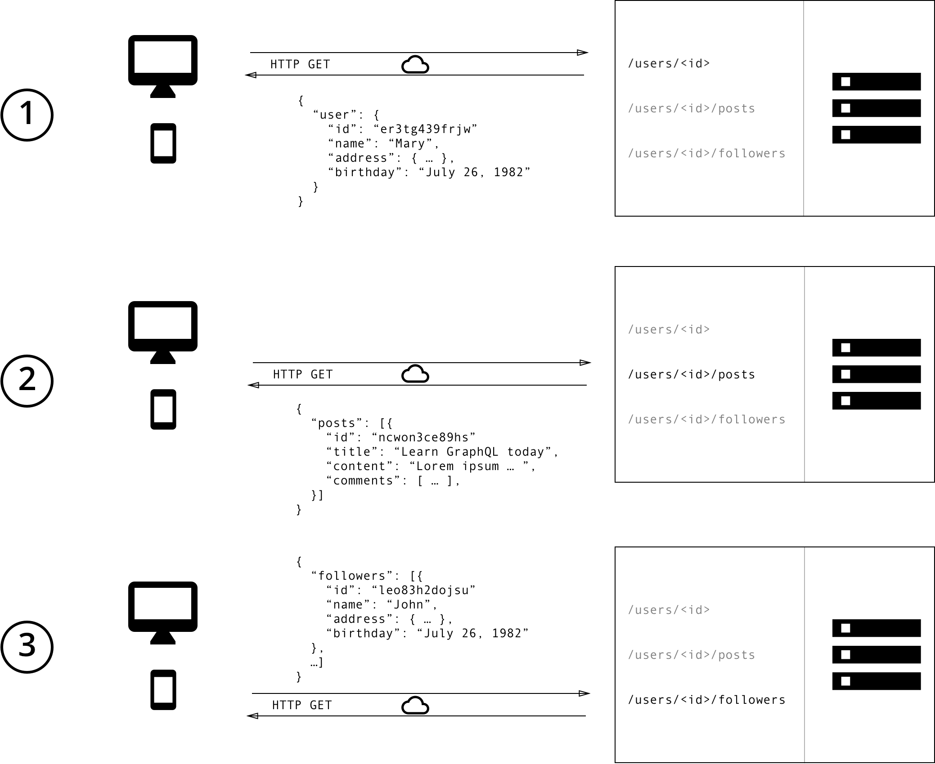
GraphQL enables efficient data loading
Image Source: HowTographQL

Slide 23
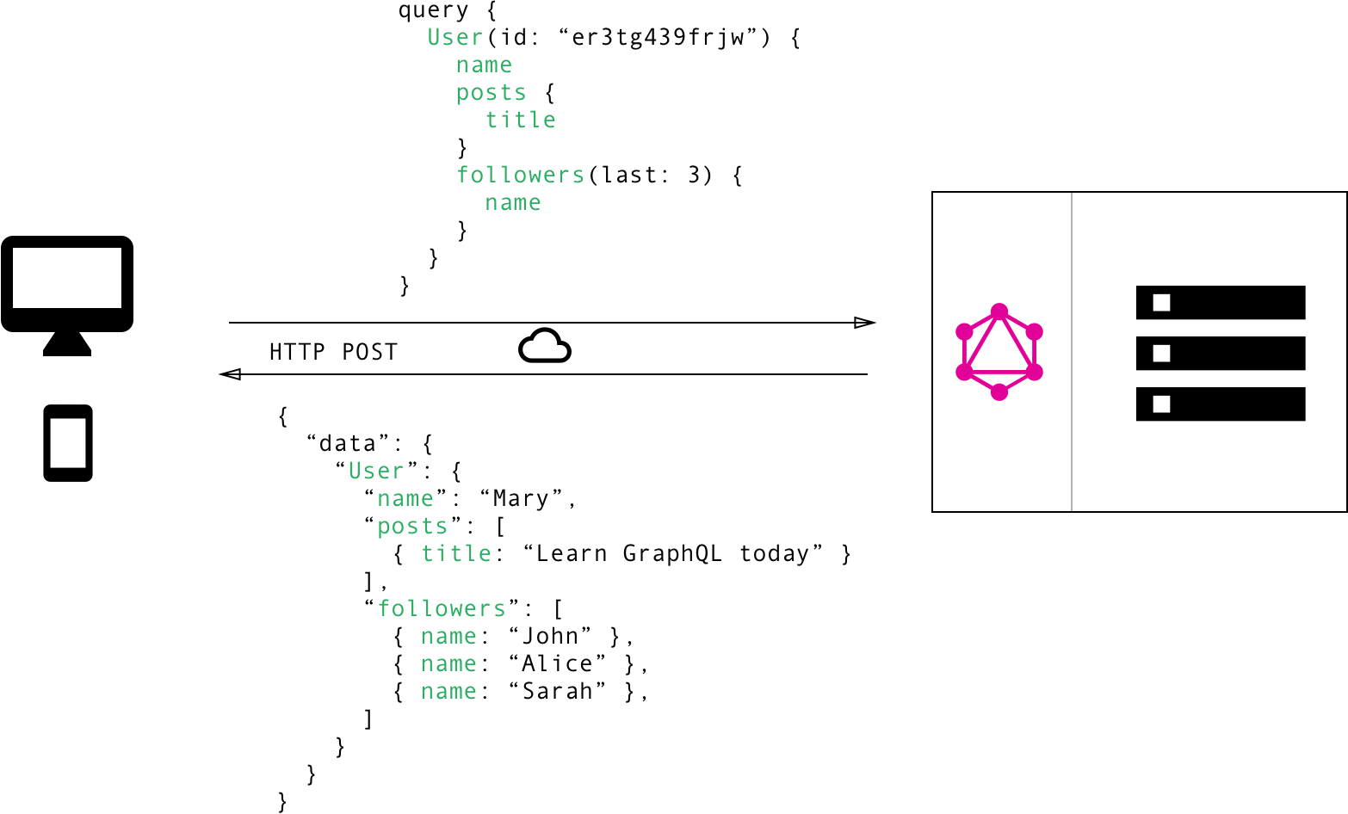
GraphQL enables efficient data loading
Image Source: HowTographQL

Slide 24
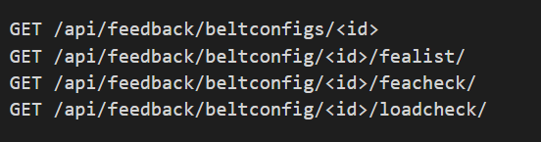
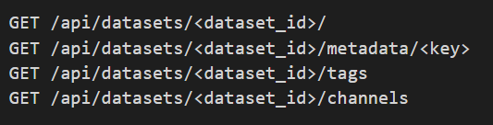
GraphQL enables efficient data loading
REST Endpoints examples from Intralox
API from Simulation Portal
API from Sensing Portal

Slide 25
GraphQL enables Fine Grain Control

Slide 26
GraphQL enables Fine Grain Permissions Checks
Because we can write resolver for each node, it is possible to perform permission check on every node.
If the user is not a VP, don’t return services fields

Slide 27
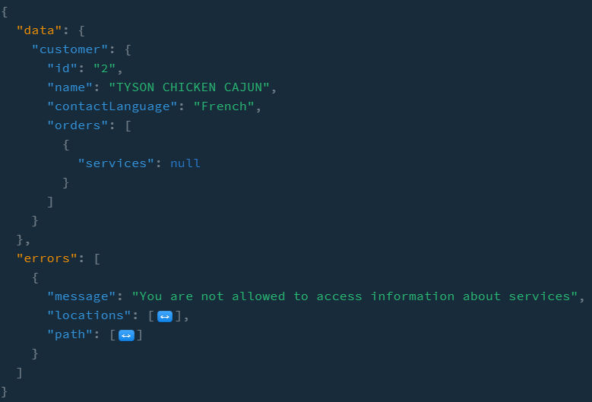
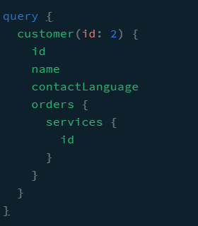
GraphQL enables Fine Grain Error Messages
Because of permissions check, we also get fine grain error messages.
Data that can be fetched is returned along with error message.

Slide 28
GraphQL enables writing less code
Data plumbing is taken care of by GraphQL runtime.
Do not need any extra code for arbitrary ways of traversing the graph

Slide 29
GraphQL is Self Documenting

Slide 30
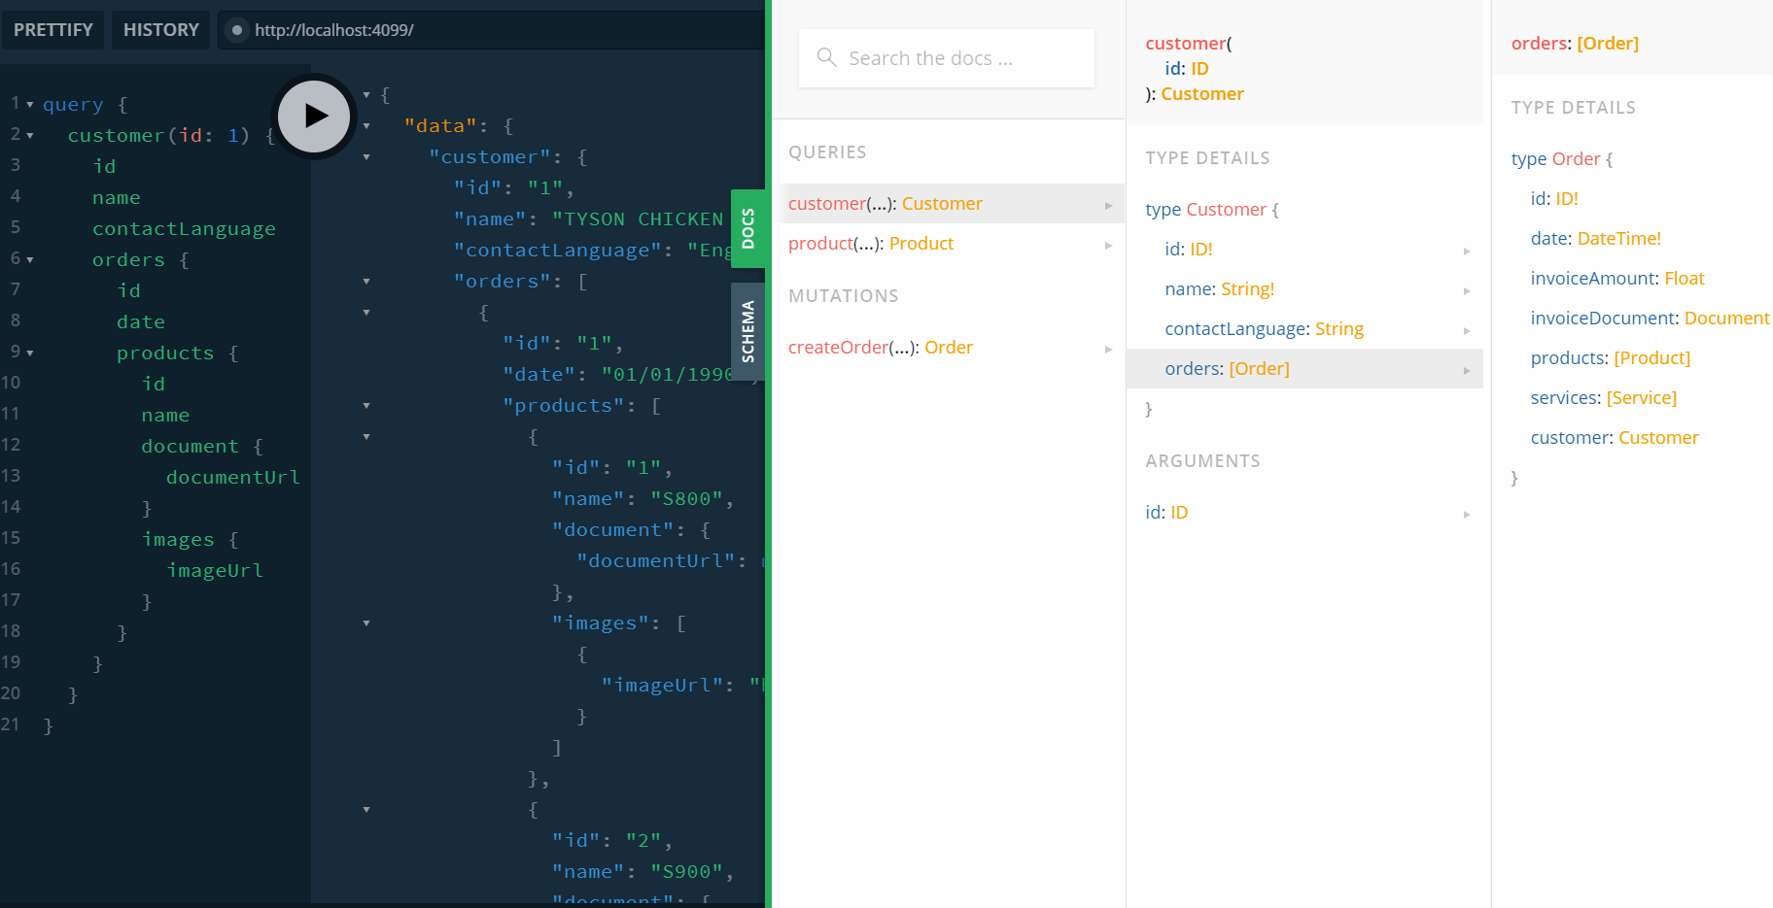

Slide 31
GraphQL is a perfect fit for
Complex Interconnected Systems

Slide 32

GraphQL enables easy ways to combine different data sources
Tridion for Documents
Images Library for Images
CXP
Dynamics/ oracle for Account/ order Data
Calclab for calculators
Mongo for User Sessions

Slide 33
Real Demo + Questions?
Demo Topics
Schema Review
Resolver Review
Quick chat about permissions, authorization etc.

Slide 34
Extra Slides Below

Slide 35
Benefit of thinking of app data as a graph
REST is the current best alternative. To build out our two requirements here are the rest endpoints. Compare this with GraphQL in later slides
REST Endpoints
/customers | Returns list of customers
/customers/id | Returns info about customers
/customers/id/orders | Returns orders for the customer
/orders/id/documents | Returns documents related to a specific order
/orders/id/images | Returns images related to a specific order
/products/id/images | Returns images related to a specific product
/products/id/orders | Returns orders for product with a certain id
/orders/id/documents | Returns documents for a specific order

Slide 36
Challenges with REST
Have to know requirements ahead of time.
As a project evolves, new APIs get added to fulfill specific data requirements of evolving application.
Clients and Front end developers do not have a automated way to know what’s possible and how to query it.
Always dealing with over-fetching or under-fetching

Slide 37
GraphQL enables more efficient caching
With GraphQL, each Node is cached which creates efficiencies in caching
Compare with REST where resources are cached based on URL
Consideration:
Node level caching is generally more complex to implement than URL level caching
Luckily the community has already developed lots of libraries for caching.

Slide 38
Consideration with GraphQL
Simple web apps with 1 data source and limited API
Mature applications where REST has been working, and there are no plans for extending the application.
Applications where performance efficiency is the most important criteria of success
Especially important if you have one data source with complex queries

